Slide 1


Veterans Demonstration Project: Asset Mapping and Gap Analysis State Council for Higher Education of Virginia Military Education Advisory Committee Monday, June 20th, 2016
Presented By:
Martha Mead, StreamLines, LLC
Chris Davidson, Virginia Tech Institute for Policy & Governance
Notes:
Martha – Introduction

Slide 2
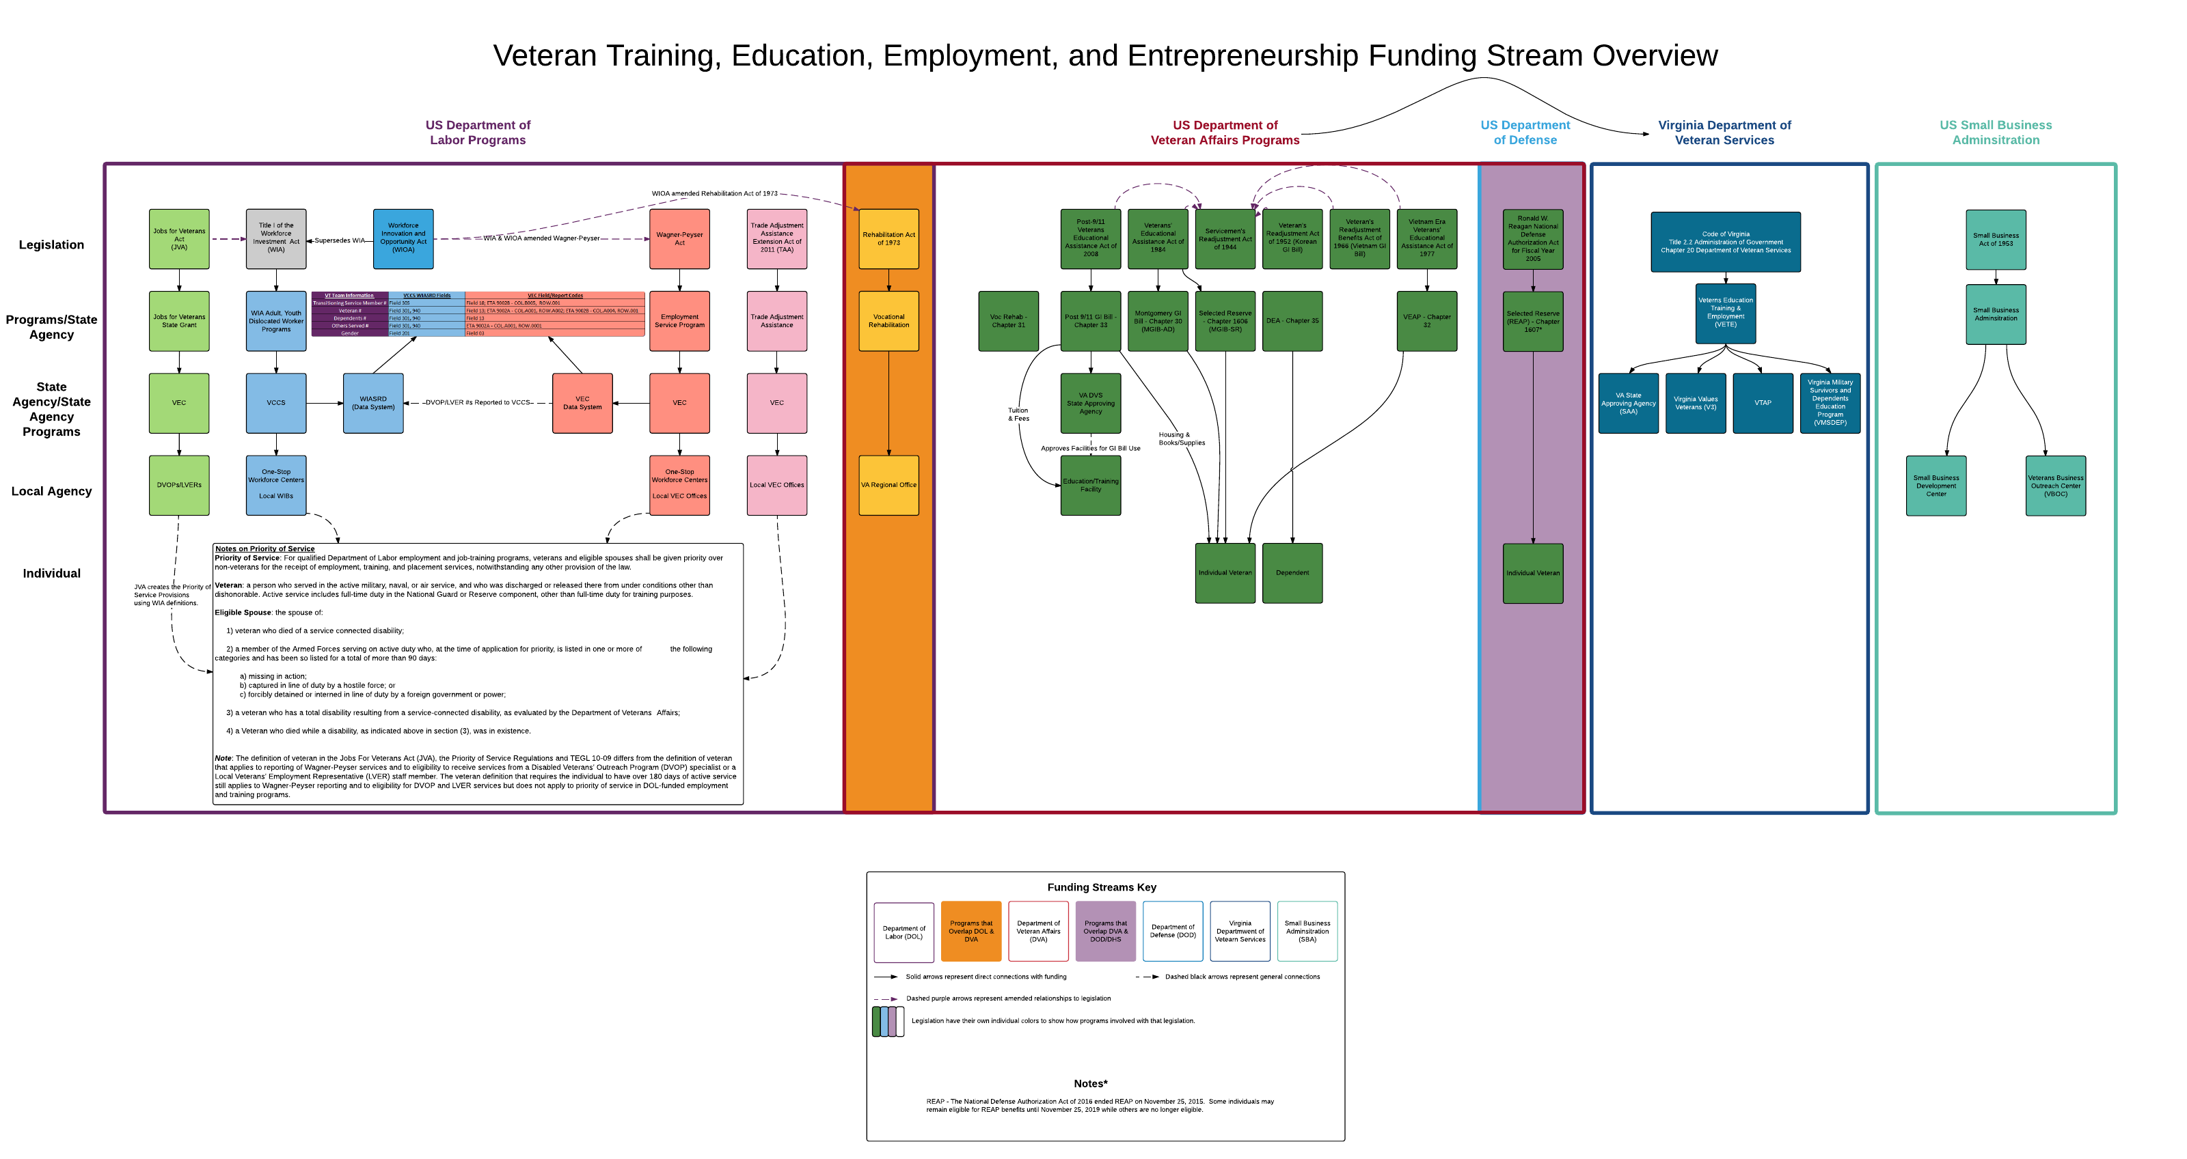
Funding Streams Overview
Notes:
Martha - Demonstrates the complexity of the support system and why TSM and veterans perceptions of fragmentation are well grounded

Slide 3
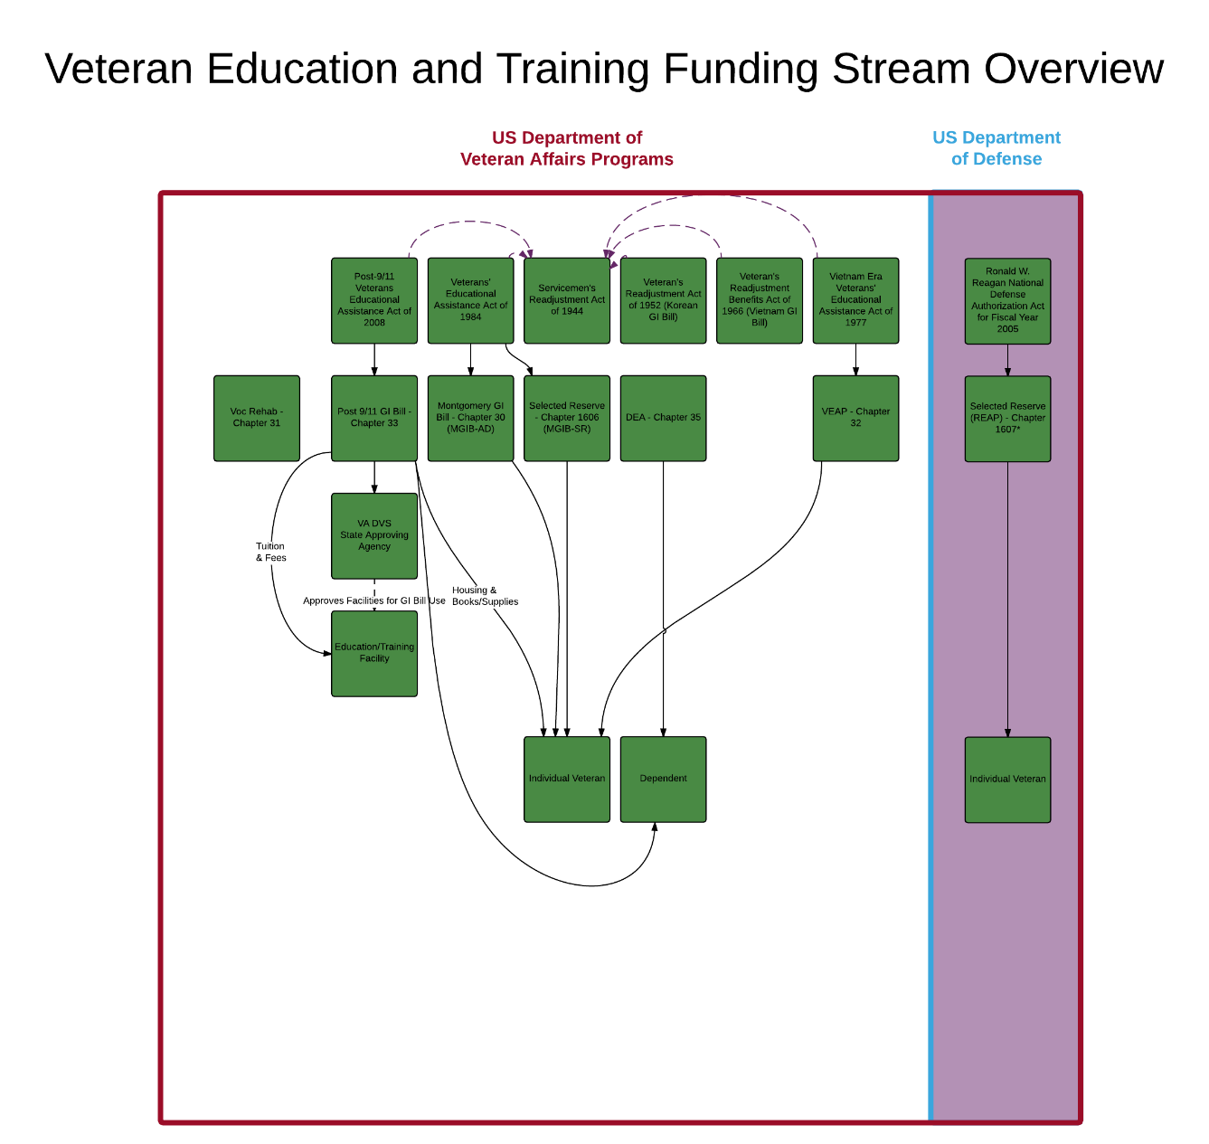
Education and Training
Notes:
Martha

Slide 4
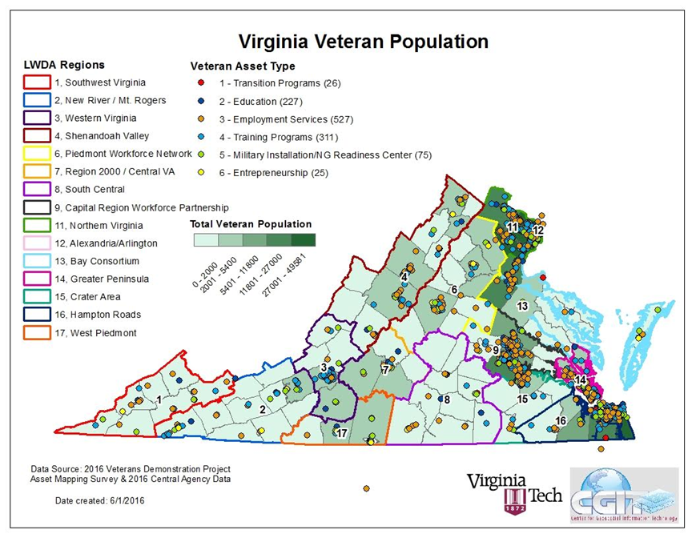
Virginia Veteran Population with All Asset Types
Notes:
Martha

Slide 5
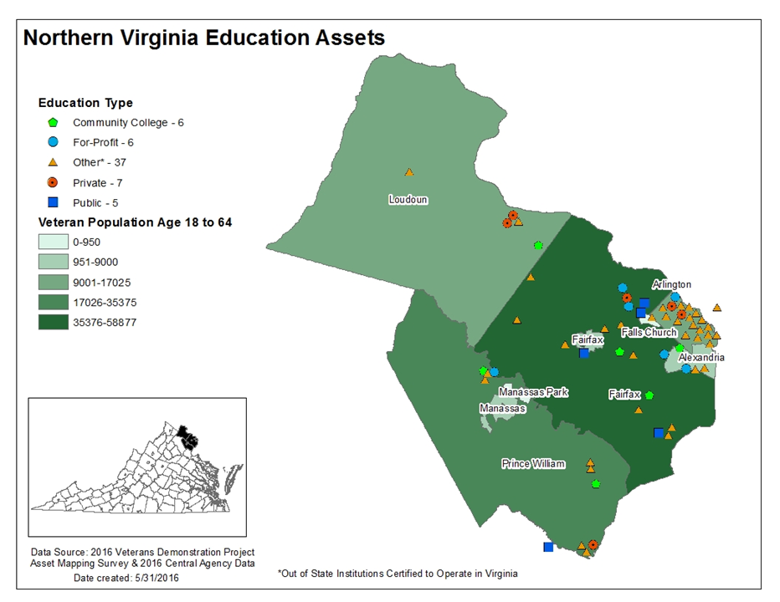
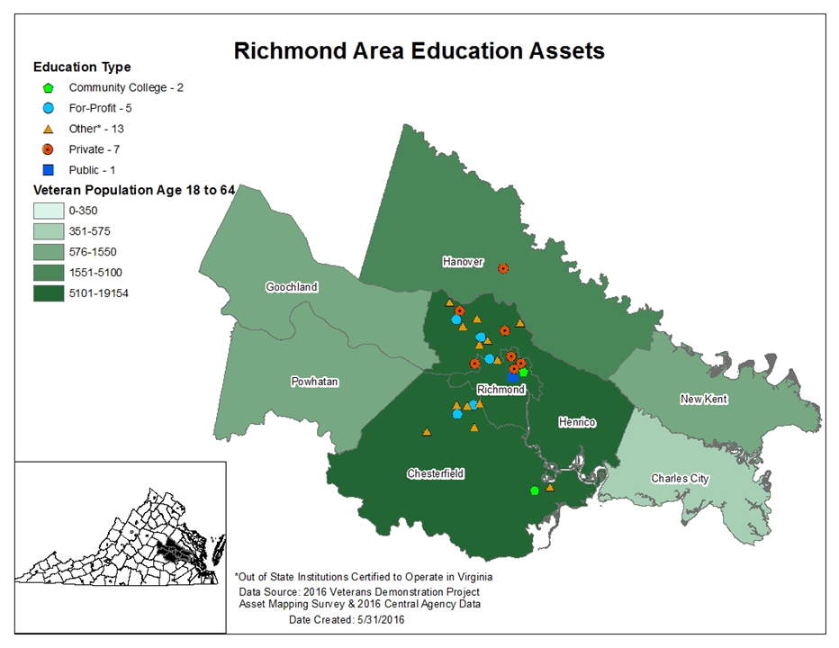
Regional Maps - Education Assets
Notes:
Chris - Note that these are GI Bill Approved

Slide 6
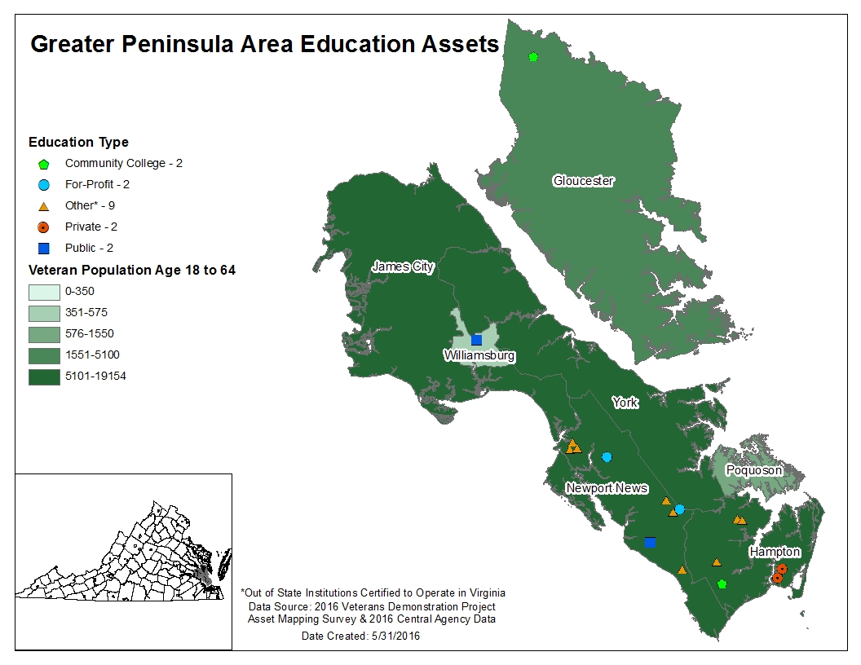
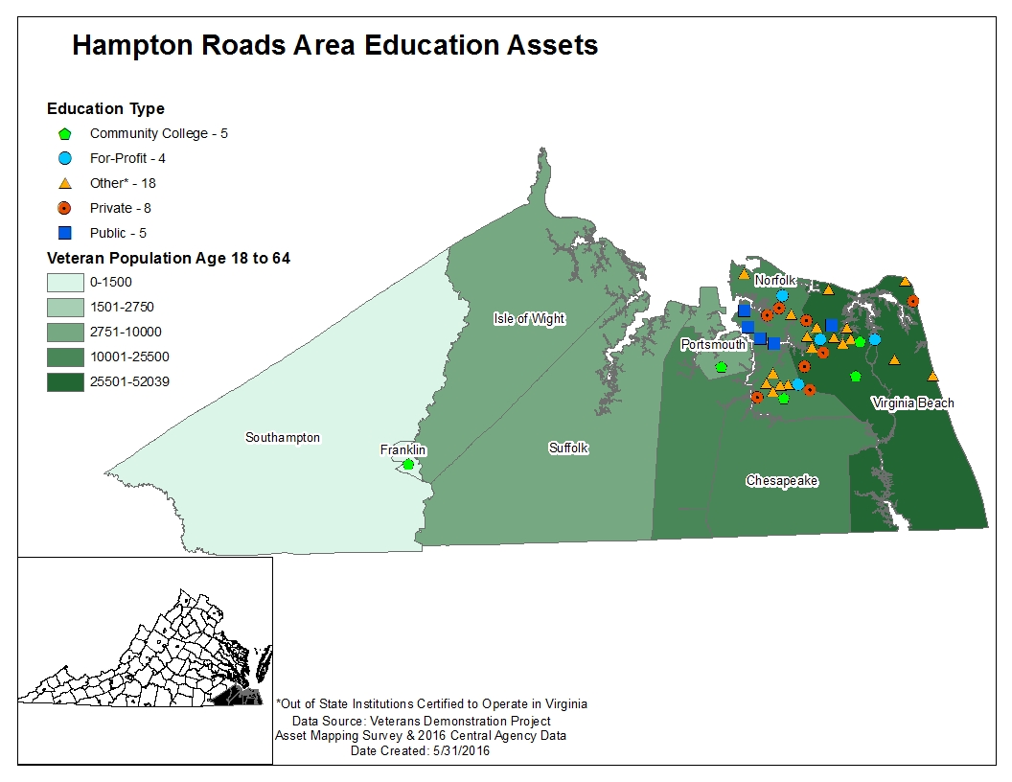
Regional Maps - Education Assets
Notes:
Chris - Greater Peninsula Area Hampton Roads

Slide 7
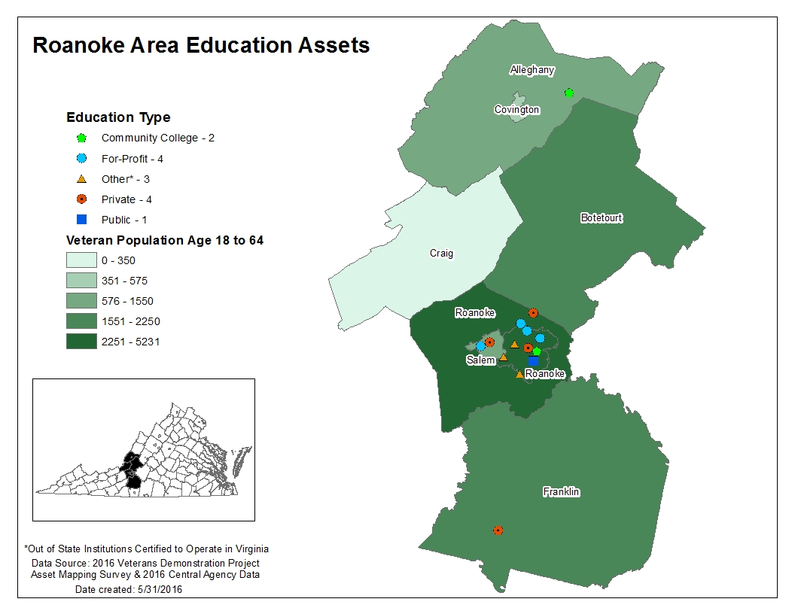
Regional Maps - Education Assets
Notes:
Chris – Roanoke

Slide 8
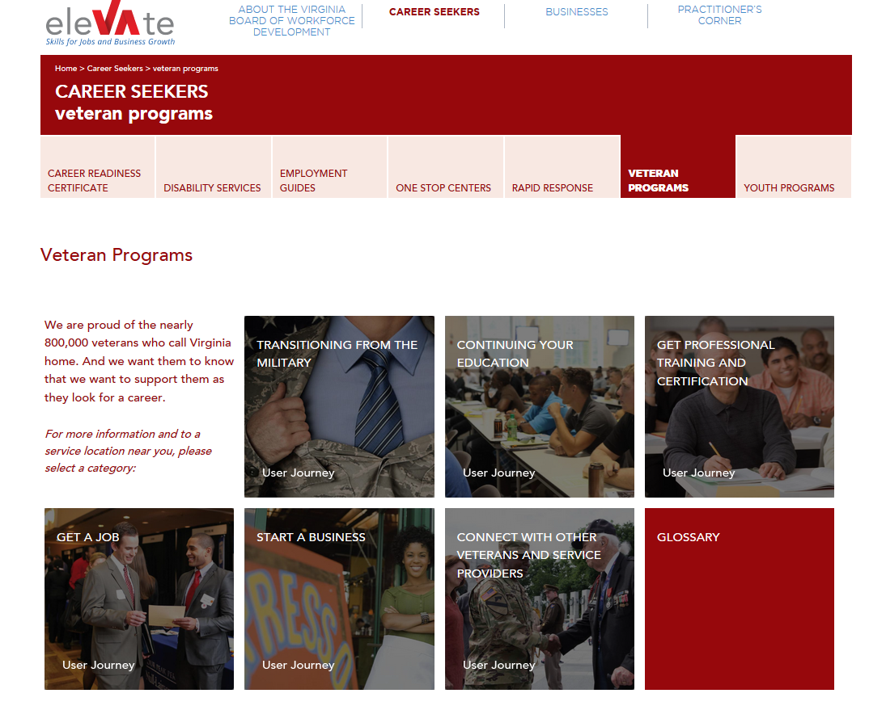
Website Integration – Prototype
http://vwnstaging.wpengine.com/career-seekers/veteran-programs/
Notes:
Martha - Of the preliminary recommendations a centralized data/web portal is at the top

Slide 9
Preliminary Recommendations from the Gap Analysis
Educational Credit for Prior Learning
Making credentials transferrable from the military to civilian life with accelerated credential attainment programs
Having the Virginia Community College System create a systematic and system wide approach to awarding academic credit for prior learning in the military
Creating shared service agreements between the different community colleges for training and certificate programs to promote access and availability
Connections with TAP – recommend assessments to help determine paths for education and/or training
Notes:
Chris - These are being addressed by another portion of the Demonstration Project as you just heard about
Related to no. 4 – Emphasis on using GI bill for educational degree when many may be better served by emphasis on professional certifications, especially where certifications would match regional workforce needs

Slide 10
Preliminary Recommendations from the Gap Analysis
Ensuring Student Readiness
Having a first year experience (FYE) course geared towards veterans to acclimate them to the campus - Eastern Carolina University or Georgia Southern University
Providing more tutors for additional assistance for learning challenges and difficult courses
Provide a veteran specific orientation program for the campus so veterans can learn about their benefits, meet one another, and learn about the campus – either done as a separate orientation or a track during regular orientation
Notes:
Chris –
George Southern From Combat to the Classroom: This FYE 1220 section is designed for veterans, military service members, family members of military service personal, ROTC cadets or anyone who cares about veteran’s issues. Together we will explore cultural and social influences that may impact veterans as they transition from active duty into higher education as well as current military service members who are still serving. We will assess potential barriers to veteran success as well as resources here on campus that can assist in successful integration. Along with campus resources, this course is intended to assist in building and expanding the student’s social support network with other students in this course. This course is taught by a veteran and is designed to be interactive to allow veterans to draw upon their experiences to assist in planning their collegiate experience.

Slide 11
Preliminary Recommendations from the Gap Analysis
Ensuring Student Success
Provide employment opportunities through work-study programs on campus and at other state agencies geared towards veterans so that veterans can pursue education while earning income to support themselves and their family
Evaluate existing and creating new relationships across veteran education programs in the state between community colleges and nearby four-year institutions like Germanna CC and University of Mary Washington.
Increase the capacity of veteran representatives on campus through additional resources, including federal and state funds
Notes:
Chris –
Note that while GI Bill benefits provide stipends not enough to support family, which it isn’t mean to. We know that one barrier to a student success is having to work a large number of hours outside of their studies. If we can get them jobs on campus, then they can become more engaged on campus which has been shown to increase success and persistence
Germanna provides a warm hand-off and follow-up with students that transfer to Mary Washington

Slide 12
Next Steps
Next Steps in Asset Mapping and Gap Analysis
Review of Asset Mapping and Best Practice Reports with Steering Committee and other stakeholders. Ongoing updating of asset data and web prototype.
Finalize gap analysis components (surveys and electronic focus group), conduct analysis and submit draft report (August 1)
Submit executive summary report with detailed recommendations (August 7 – Steering Committee; VBWD – August 15)
Notes:
Martha

